Slide 1
PDSC-PACK Creator v0.0.1
Mirco Palese
Computer Engineering student at Universita’ del Salento – Lecce (Italy)
Silvio Lucio Oliva
System Research & Applications (SRA) – ST Lecce (Italy)
July 25th, 2019

Slide 2
Application Overview
PDSC-PACK Creator is a Java program for PDSC file and CMSIS pack creation following CMSIS-Pack Standard (by ARM)
Main features include:
Easy to use PDSC document creator and reader
CMSIS-Pack creation starting from PDSC document
Highly scalable CMSIS-Pack standard definition

Slide 3
Used Technologies
Java 1.8.0_201
Swing (GUI widget toolkit for java)
Apache Commons IO 2.6 (utility classes, stream implementations, file filters, file comparators …)
JDOM 2.0.6 (A complete, Java-based solution for accessing, manipulating, and outputting XML data)
JIconFont 1.0.0 (API to provide icons generated by any IconFont)
JIconFont-font-awesome 4.7.0
JIconFont-swing 1.0.1
ZT-Zip (to process large set of large ZIP archives)
MigLayout 4.0 (Java Swing, JavaFx, and SWT layout manager)
MigLayout-core-5.2
SQLite 3.27.2.1 (self-contained, serverless, SQL database engine)

Slide 4
Application Features 1/2
Easy management of the standard elements and attributes
PDSC file creation with required elements and attributes already set
Easy insertion of optional elements and attributes
Possibility to create and add custom elements
Multi file management
Add and manage multiple element <file> in few steps
Files (source, documentation, …) on file system are associated and copied to a destination path within the CMSIS pack
Reduces the possibility of error alerting on standard violations
PDSC file validation according to XSD schema

Slide 5
Application Features 2/2
One click CMSIS pack creation from PDSC file
Update an existing CMSIS pack editing the PDSC file
Update the CMSIS-Pack Standard database through the application User Interface <!-- not available yet -->

Slide 6
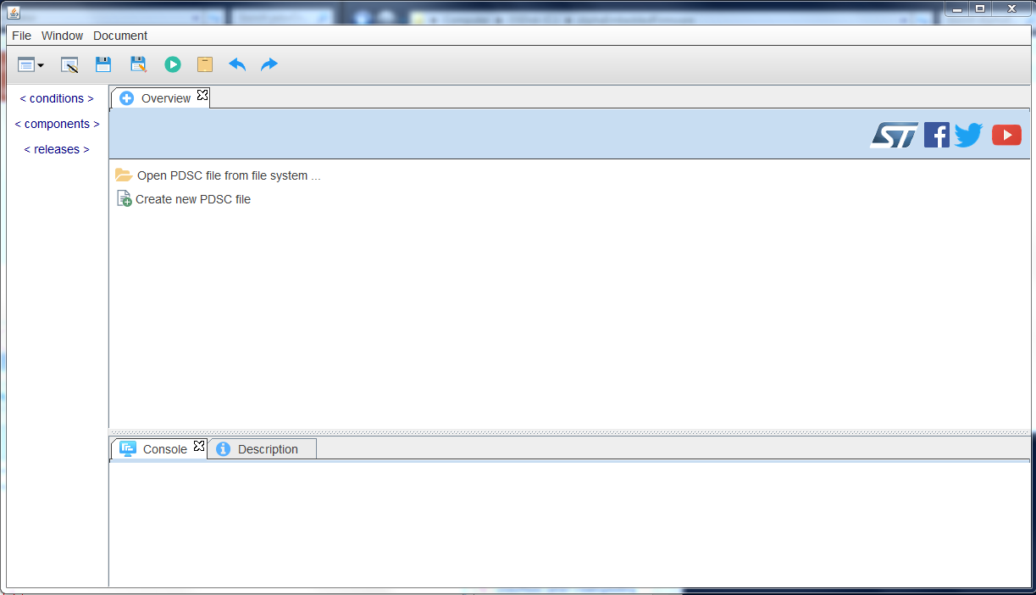
Application UI
6
7
8
9
10
11
12
14
Create new PDSC file
Open PDSC file
Optional tag list (i.e. the list of the <package> optional child elements) TBC
Show result from XSD validation (see 10) and other log messages
Show the element/attribute description as reported in the CMSIS-Pack standard TBC
Same as 3
Hide/Show the tag list in 3
Save PDSC
Save PDSC with name
Run XSD validator
Create CMSIS pack
Undo/Redo (when creating/editing PDSC file) TBC
Go to ST website and social accounts
Drop down menu with “Run XSD validator” and “Show PDSC file preview”
3
2
13
1
4
5
TBD To be done
TBC To be completed

Slide 7
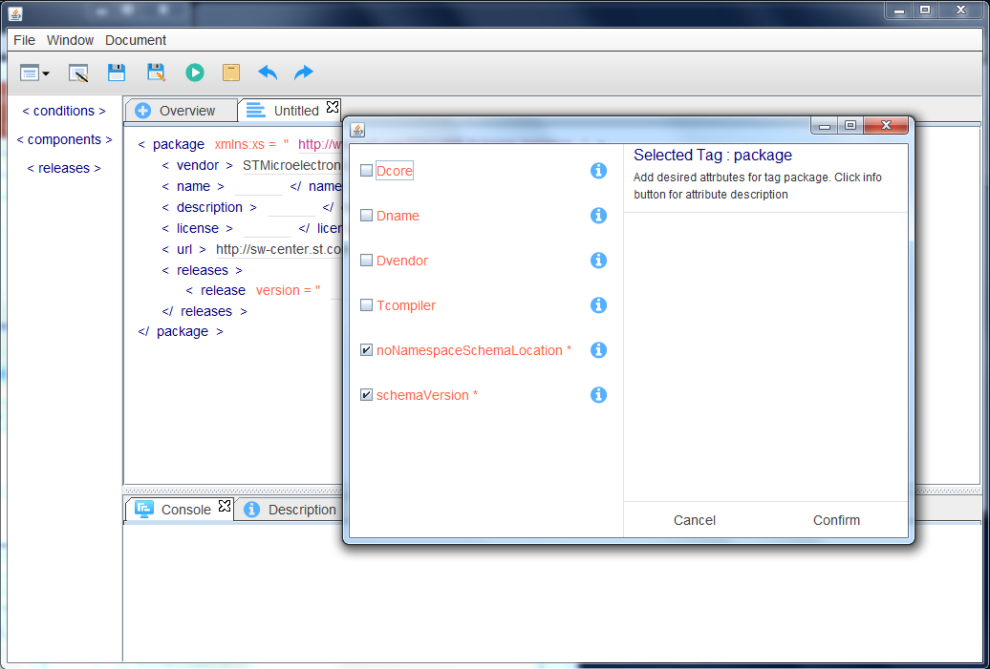
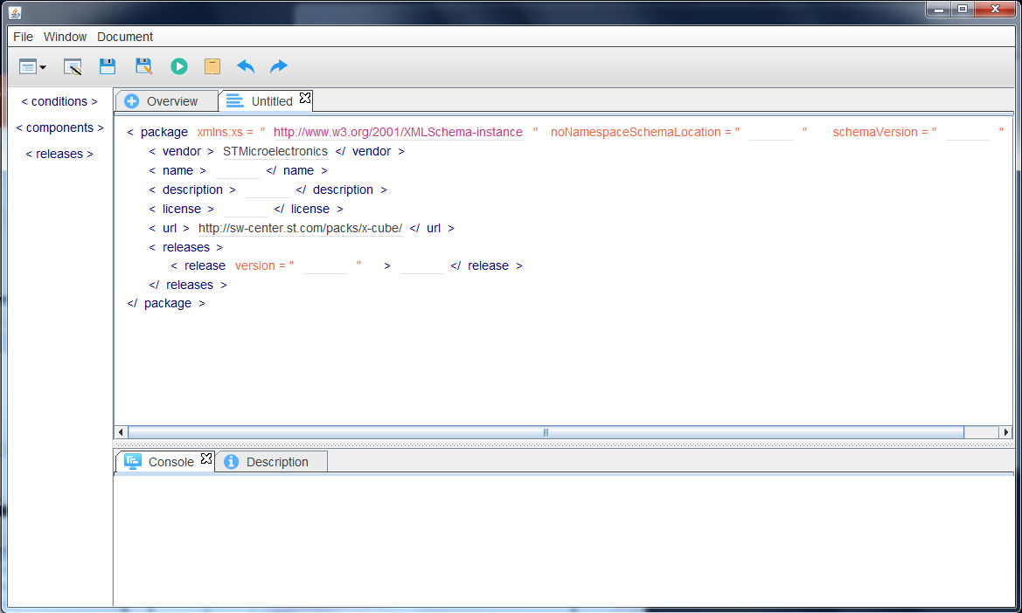
Getting started
1
A
Clicking 1 from the Overview tab a new tab with the typical pdsc structure will be created
The <package> element is created with the mandatory (required) child elements added by default
At the same time a pop-up window provides the user with the possibility to select the attributes to be added to the <package> element
In the pop-up window the mandatory attributes are shown checked by default
Checking the attributes to be added and clicking Confirm the pdsc structure will be updated (see C)
Here it is also show that some field is filled by default with the value an ST developer most likely will use (e.g. <vendor> and <url>)
B
C

Slide 8
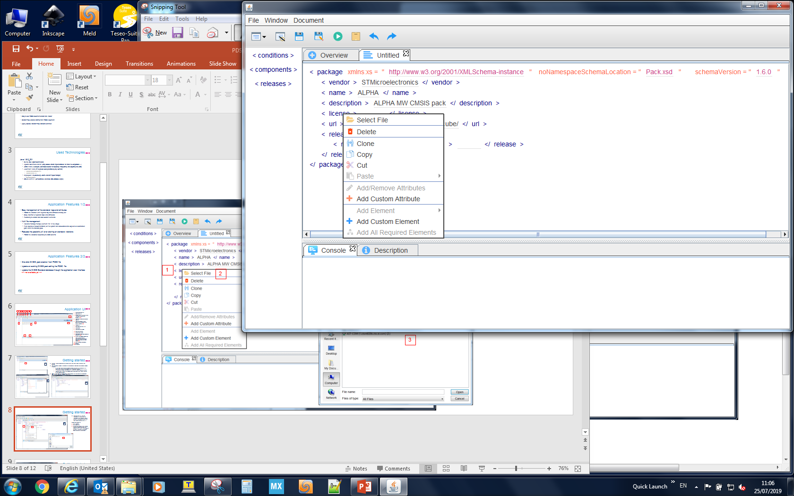
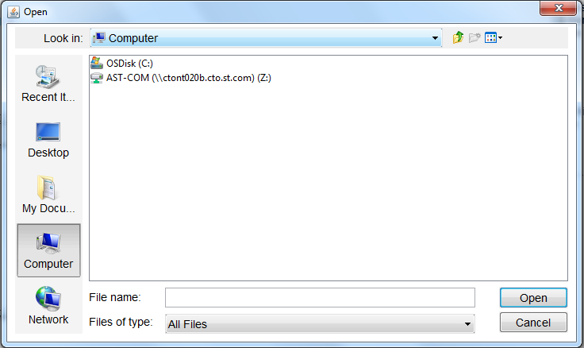
Getting started
The user can start filling the attributes and the child elements of the <package> element adding manually the schemaVersion, the <name>, the <description>, ….
To add the license file
click <licence>
click Select File
the user can browse his PC through a pop-up window and select the license file (this file will be included to the pack at the end of the process when the pack will be created)
D
1
2
3

Slide 9
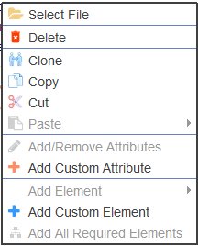
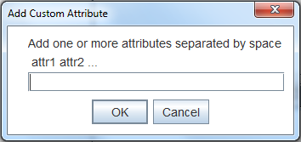
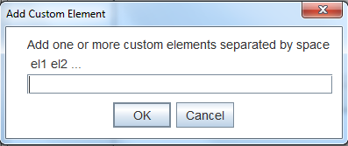
Getting started
Here it is provided a short description of the menu items appearing after clicking an element
Select a file from the user’s PC
Delete the element
Add to the parent element a perfect copy of the selected element
Copy the element into block notes
Remove the element after copying it into the block notes
Paste the last copied element (5) into a selected element (the best position where to copy it into the parent element can be selected by the user)
Add/Remove standard attributes to an element
Add/Remove custom attributes to an element (in case a new attribute is standardized by ARM and the application is not aligned to the latest CMSIS-Pack standard version)
Add/Remove standard child element
Add/Remove custom child element to an element (see comment reported in 8)
Add all required child elements and their required attributes in one click
If an element have no attributes/elements or a specific function cannot be applied to it the relative menu item is disabled.
Concerning features 8 and 10, it will be added the possibility, after creating it, to save a custom Attribute/Element into the database (that is part of the application) where the CMSIS-Pack standard is stored. In such a way it will be possible to keep the application updated according to the CMSIS-Pack standard changes.
E
1
2
3
4
5
6
7
8
9
10
11

Slide 10
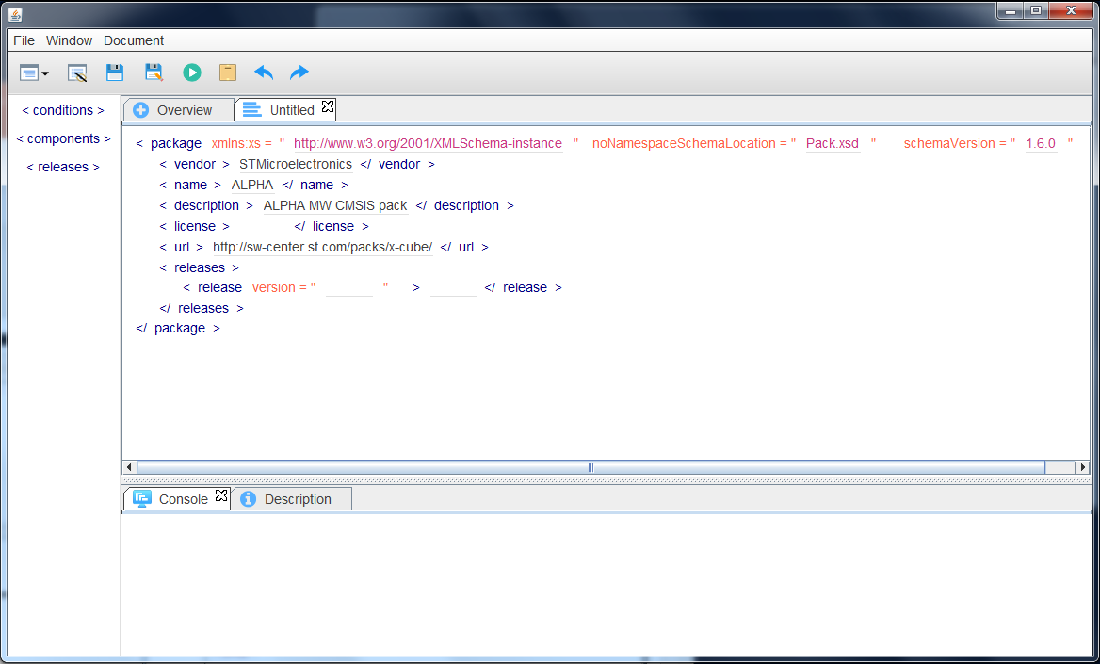
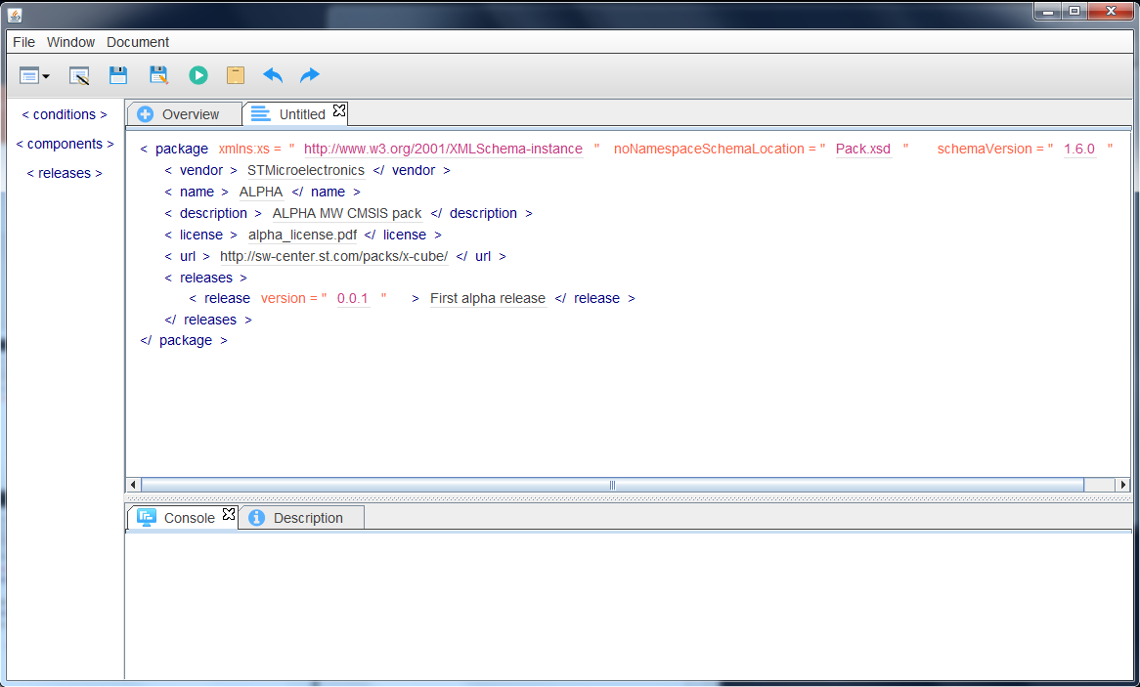
Getting started
F
Following the instructions provided in the previous slide, the fields related to all required elements and their attributes can be completed adding the license file and indicating the release version and description (see G)
G

Slide 11
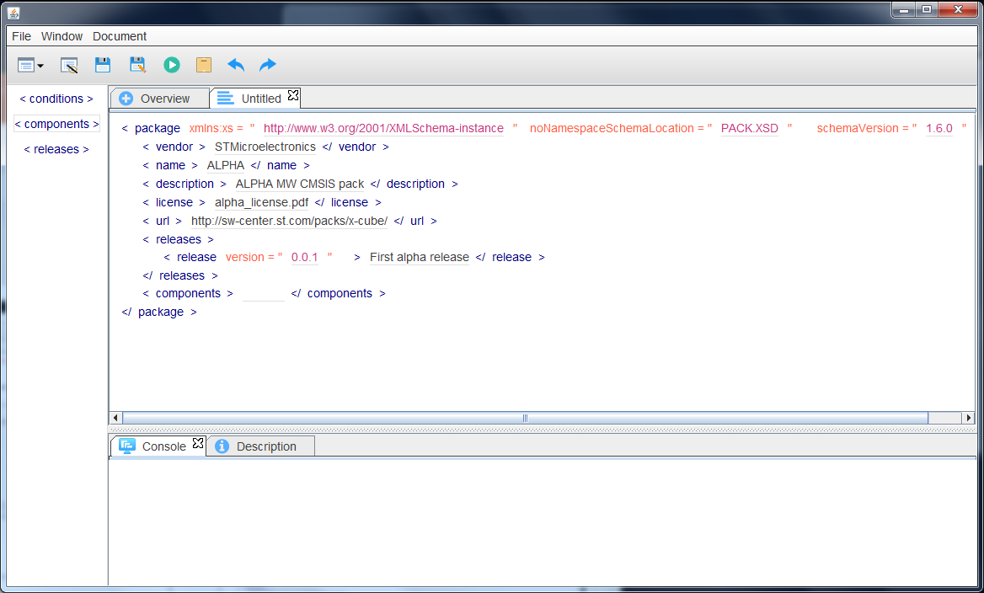
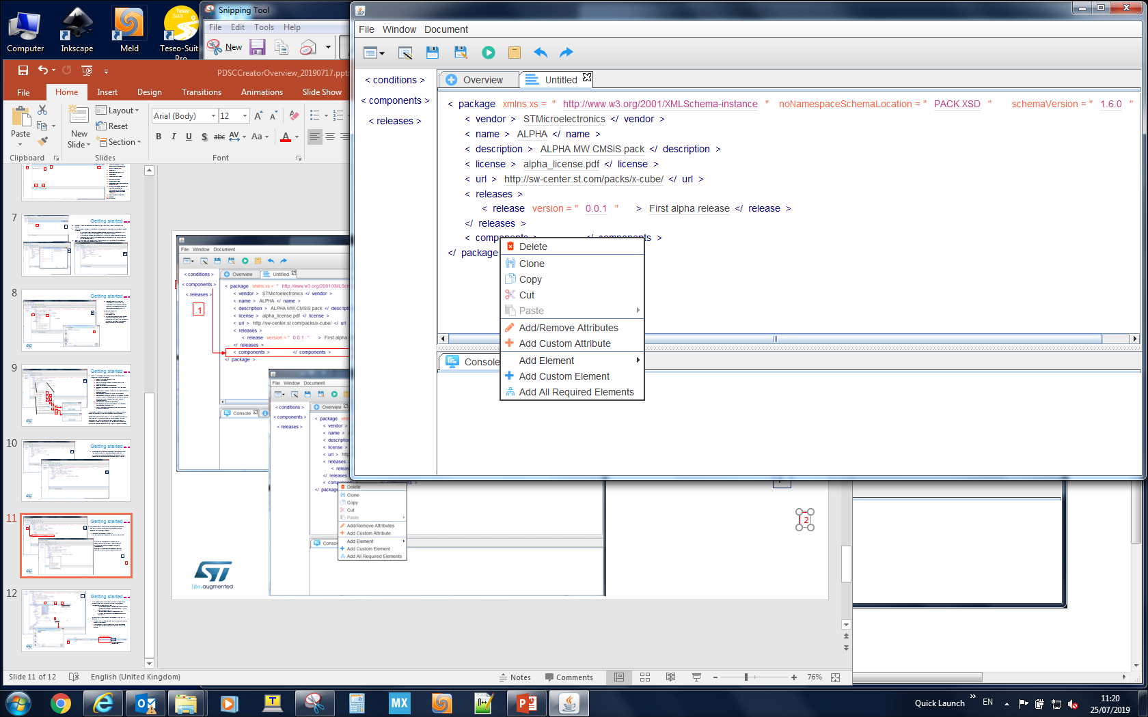
Getting started
H
H.
After completing all fields related to the required elements and their attributes, the optional child elements can be added to the <package> element
Click one of the elements listed in 1
It will be automatically added to the pdsc structure tab
1
I.
Clicking the <components> element in the pdsc structure tab the user is able to add the attributes and the child elements related to <components>
Clicking 2 all required child elements and their required attributes can be added automatically
I
2

Slide 12
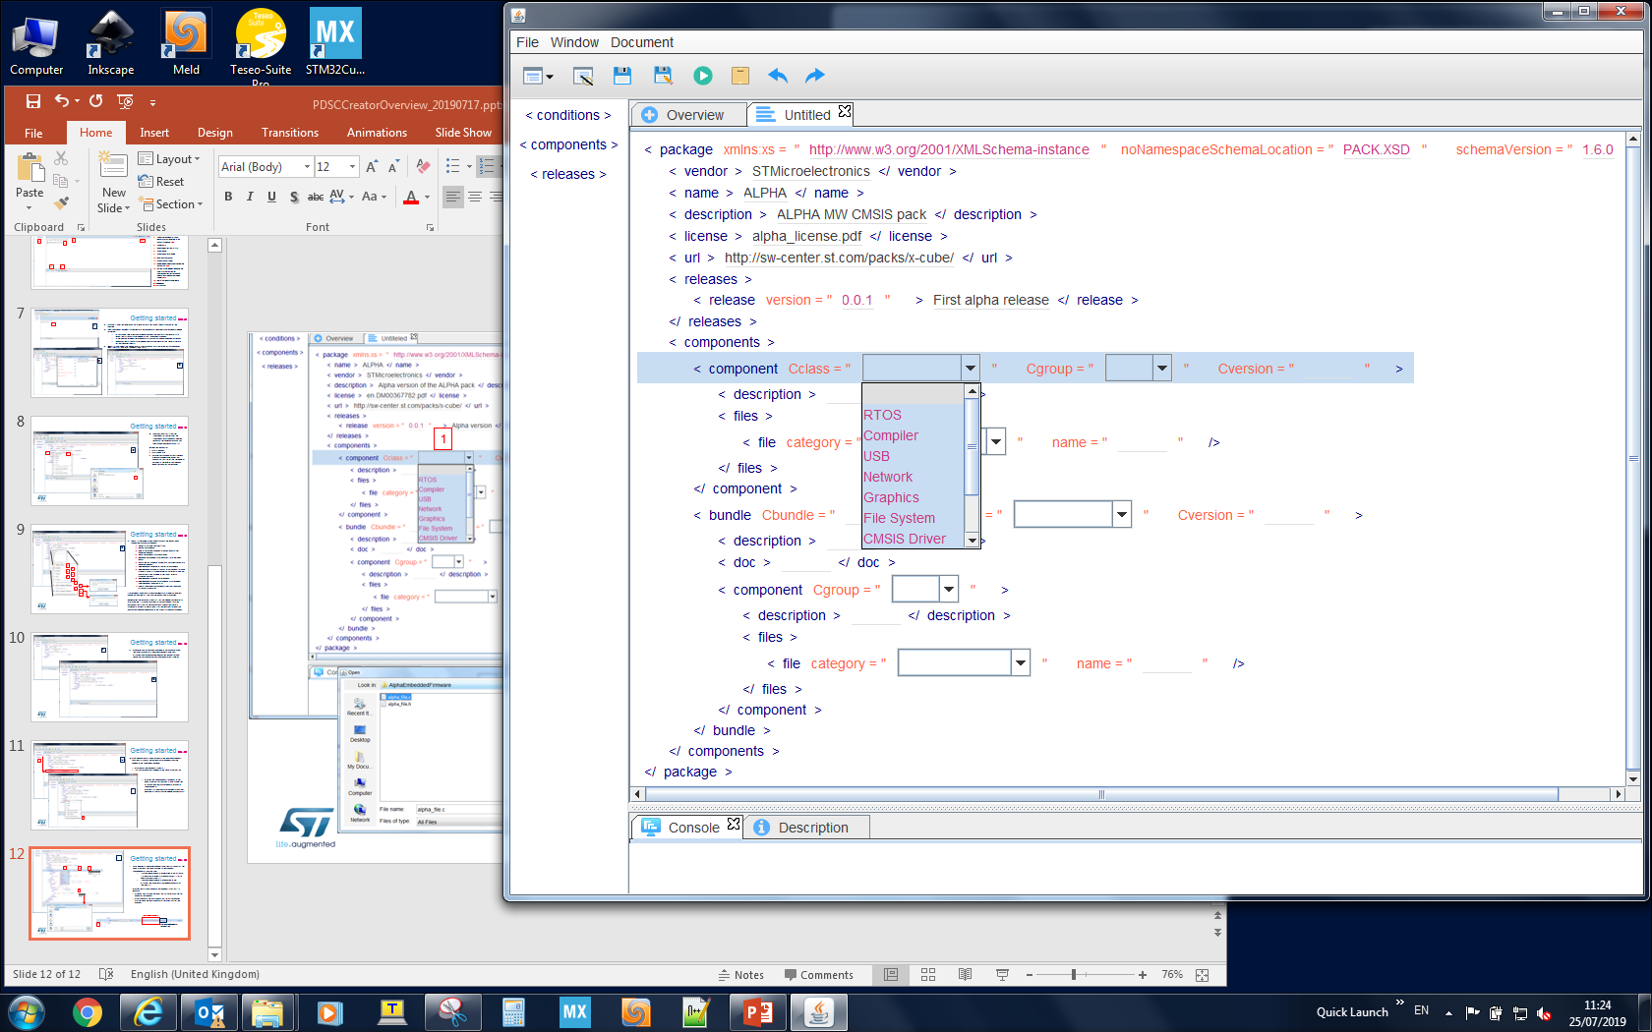
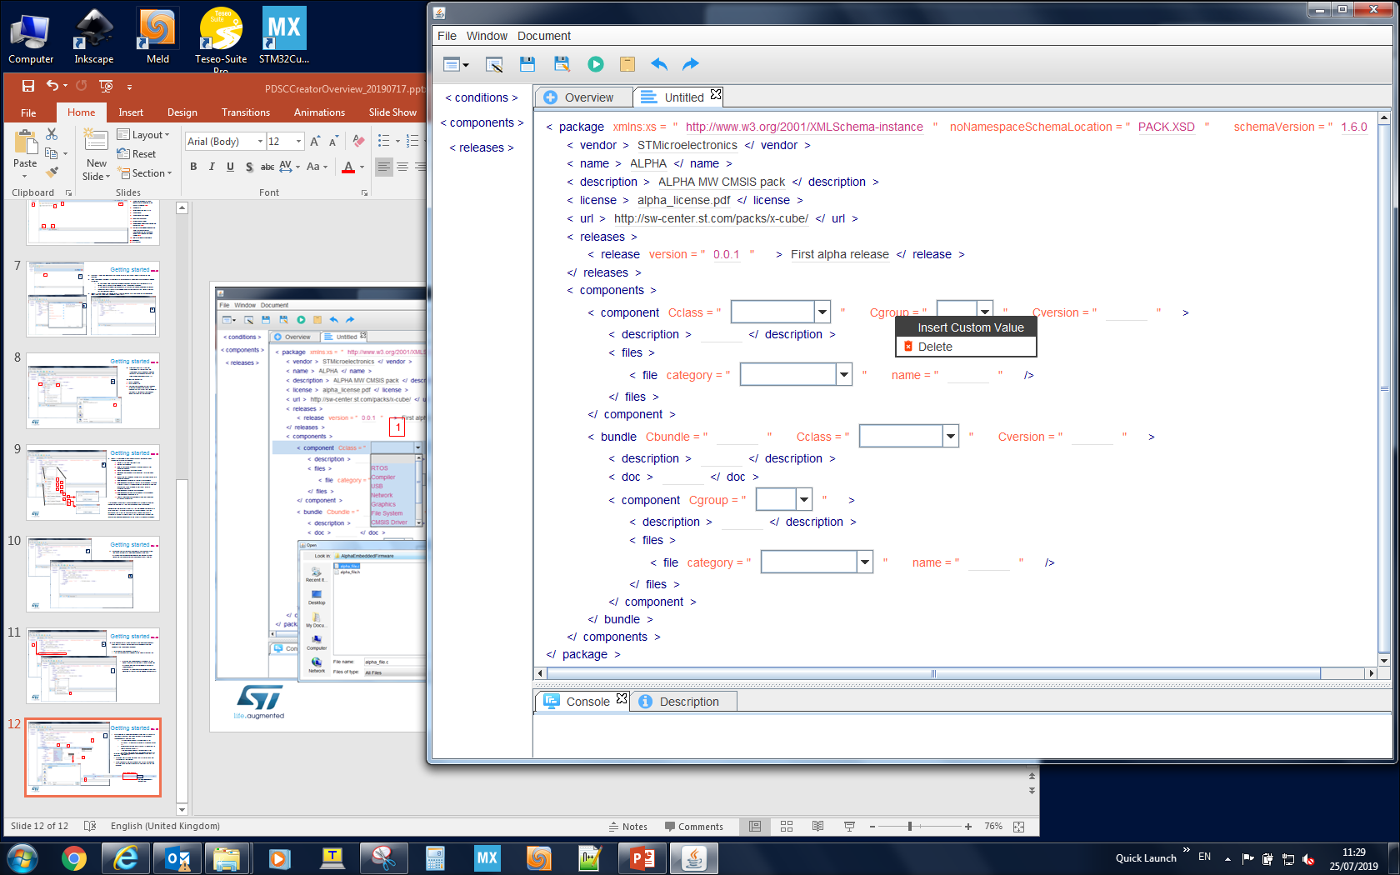
Getting started
After adding all required elements and their attributes to the pdsc structure, the fields related to the element <components> can be filled
If a drop down menu is associated to an attribute it is possible to select a standard value (1)
Otherwise clicking the attribute it is possible to add a custom value (2)
If no drop down menu is associated to the attribute, the value must be added manually by the user (3)
I
1
2
3

Slide 13
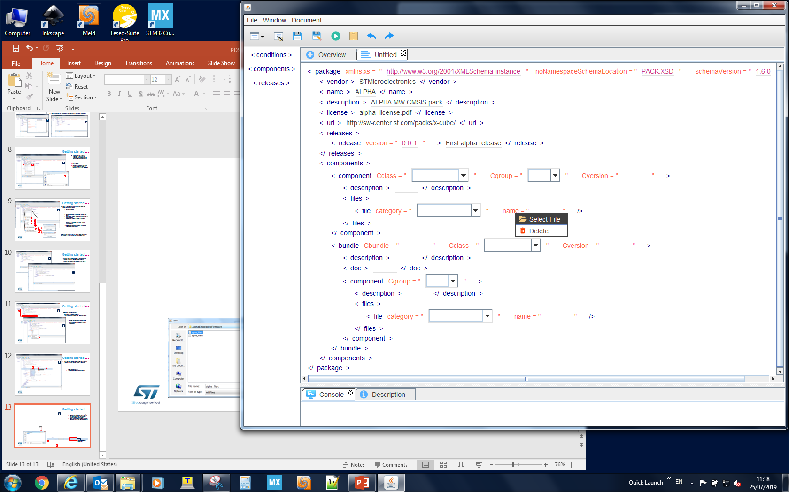
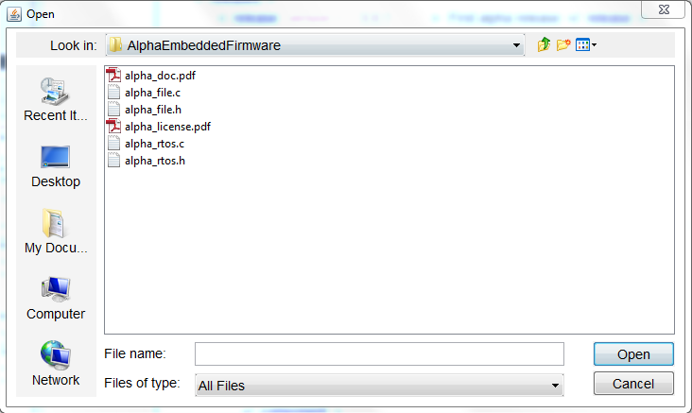
Getting started
J
Clicking the attribute name of the element <file>, it is possible:
To select the file from the user’s PC → in the pdsc structure only the filename is shown (the source path is hided)
To set manually the path where that file will be copied starting from the root directory of the pack that will be created at the end of the process
Path added manually
File taken from the user’s PC

Slide 14
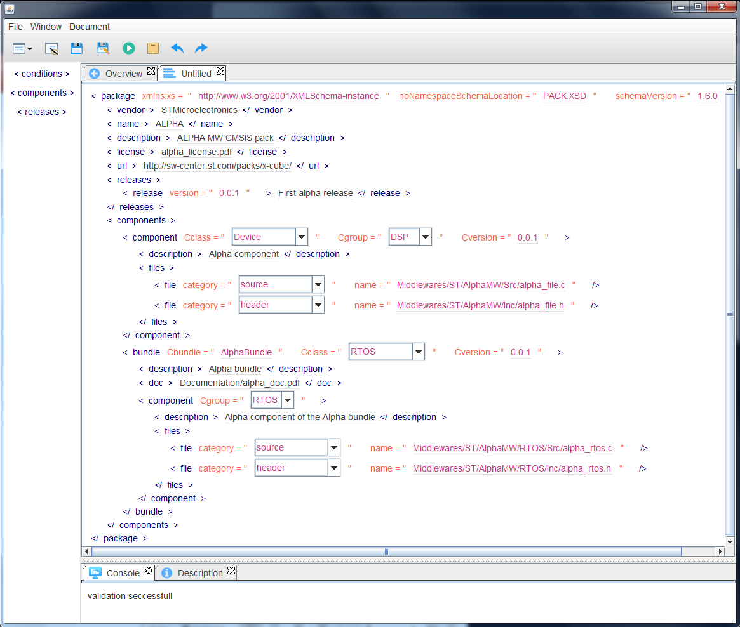
Getting started
1
K
As exercise the reader can try to replicate what is reported in this slide.
Once all fields have been filled, clicking 1 the XSD validation can be launched.
If the message from the XSD validation is the one reported in 2, then the pack can be generated.
2

Slide 15
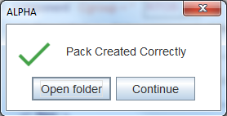
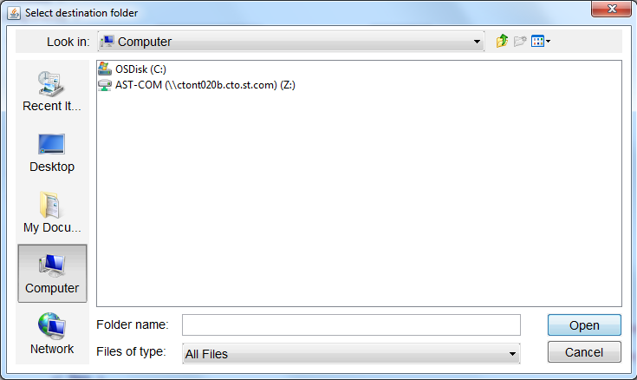
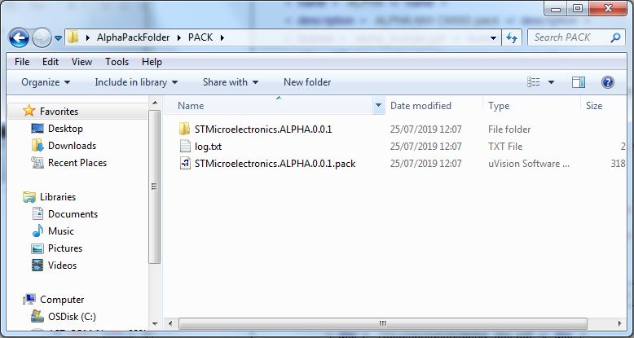
Getting started
1
L
Clicking 1 it is possible to select the folder where both the PDSC file and the CMSIS pack will be created.
After selecting the destination folder a pop-up window will notify the user about the pack creation.
The pack folder will contain:
The CMSIS pack
A folder with the unzipped content of the pack
A log file

Slide 16
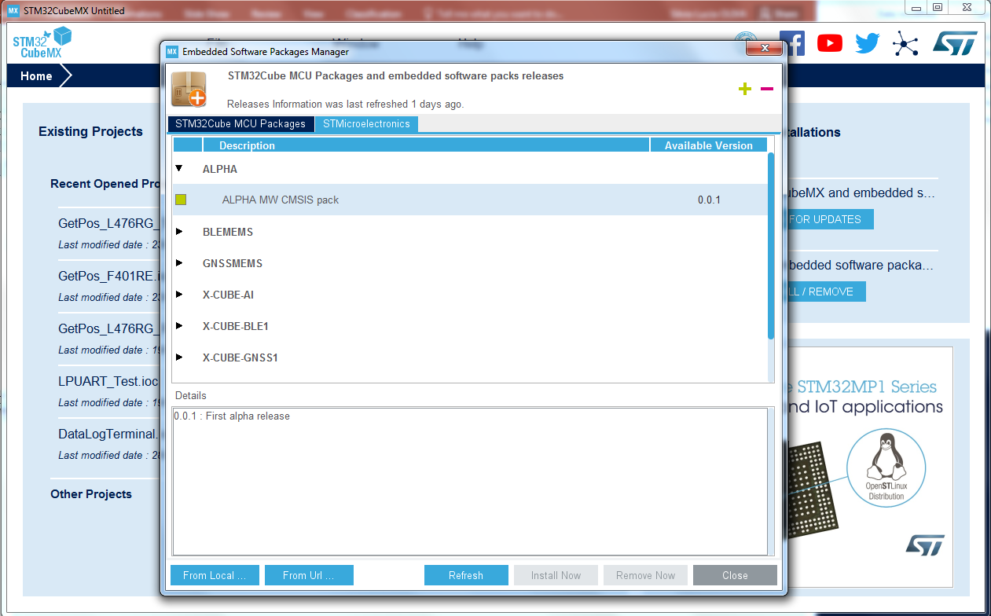
Getting started
As further verification the user can try to install the pack in the STM32CubeMX
M

Slide 17
Next steps
To complete the CMSIS-Pack standard storage into the database included in the application
To add the possibility to update the database with the Custom Attributes/Elements created by the user
To check the schemaVersion in the pdsc is supported by the XSD validator embedded in the application
To add the possibility to update the XSD validator to latest schema version
To complete all application features (undo/redo, …)

Slide 18
CMSIS-Pack Standard Database

Slide 19
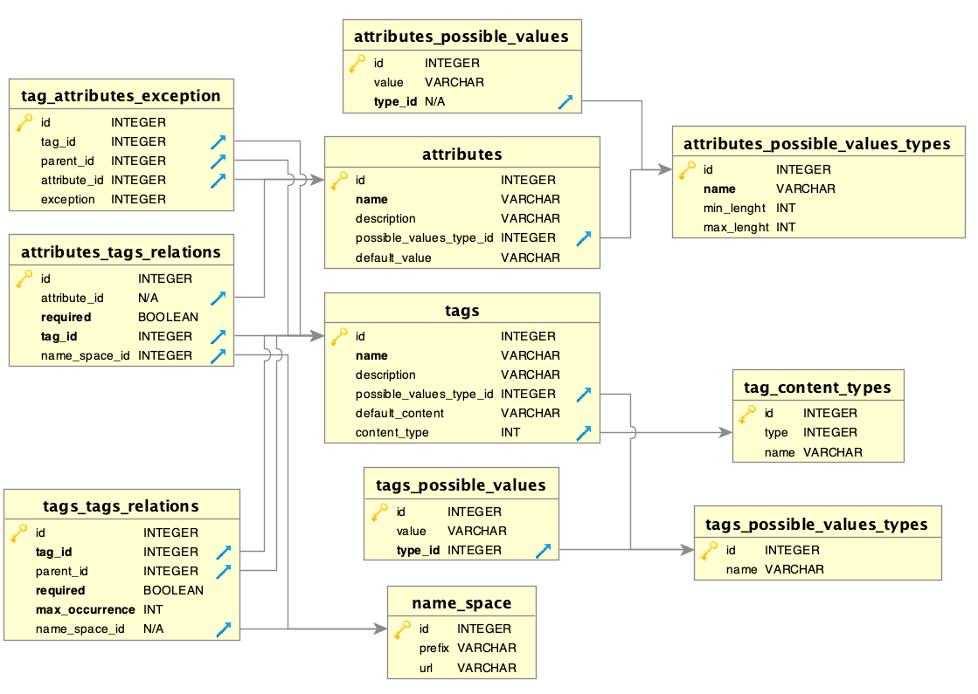

Database Overview
SQLite is an embedded SQL database engine.
Unlike most other SQL databases, SQLite does not have a separate server process.
SQLite reads and writes directly to ordinary disk files.
A complete SQL database with multiple tables, indices, triggers, and views, is contained in a single disk file.
In the database the elements are called tags

Slide 20
Database Overview
Elements Description Tables :
tags : Contains the main features of elements, like name and description.
tags_content_types : Describe content type for elements (string , void , elements … ).
tags_possible_values_types : Contains possible types for elements that have content restriction.
tags_possible_values : Contains all possible values associated with particular type.
tags_tags_relations : Contains the relationships between tags.
tags_attributes_exceptions : Contains the exceptions that elements can have on attributes in certain conditions .
attributes_tags_relations : Contains the relationships between tags and attrbiutes.
name_space: Contains the main features of name sapce.
Attributes Description Tables :
attributes : Contains the main features of attributes, like name and description.
attributes_possible_values_types : Contains possible types for attributes that have value restriction.
attributes_possible_values : Contains all possible values associated with particular type.

Slide 21

Database Manager Overview
SQLiteStudio is a SQLite database manager with the following features:
Portable, just download unpack and run.
Cross Platform runs on Windows 9x/2k/XP/2003/Vista/7, Linux, MacOS X and should work on other Unixes .
Exporting to various formats (SQL statements, CSV, HTML, XML, PDF, JSON).
Open source and free.
SQLiteStudio database editing example :
On menu: Database Add Database
On database type select : SQLite 3
Select packCreator.db located in : PDSC-PACK Creator X.X.X.jar/dbConnection/packCreator.db
Once loaded, database with all tables is located in left panel
On left panel : Double click on database icon double click on desired table

Slide 22
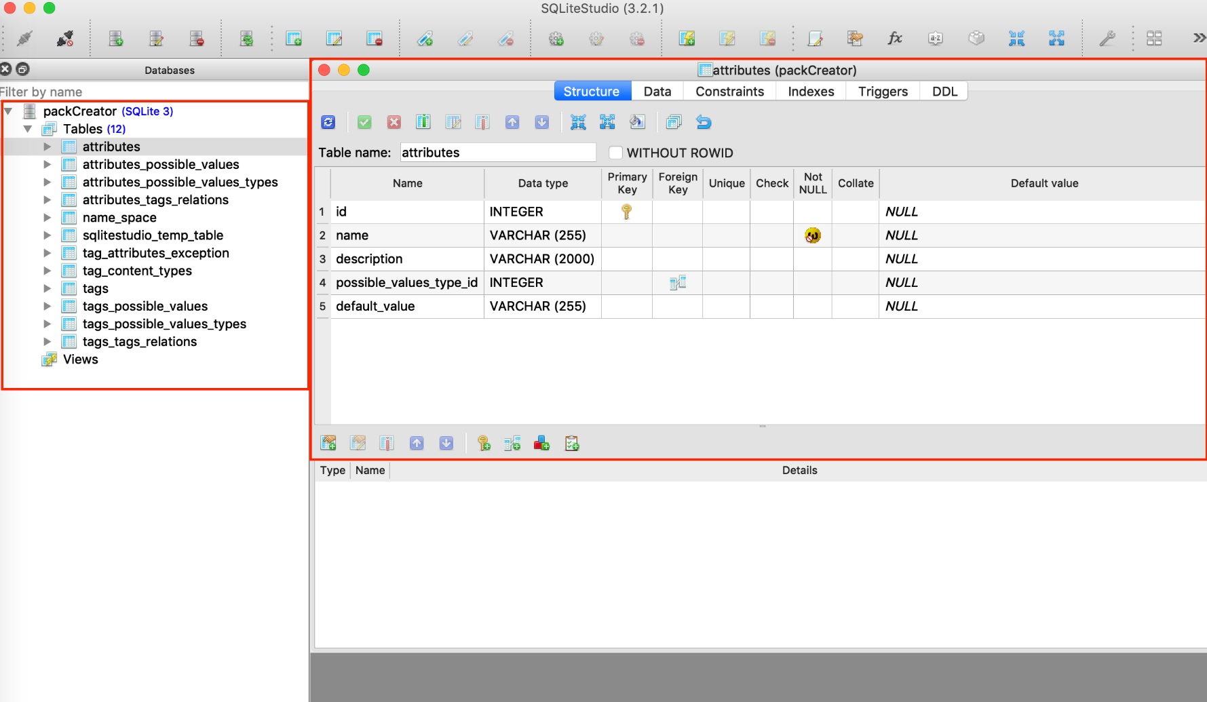
Database Manager Overview
Table is loaded on right panel
Left panel with database and all relative tables
Right panel with table overview

Slide 23
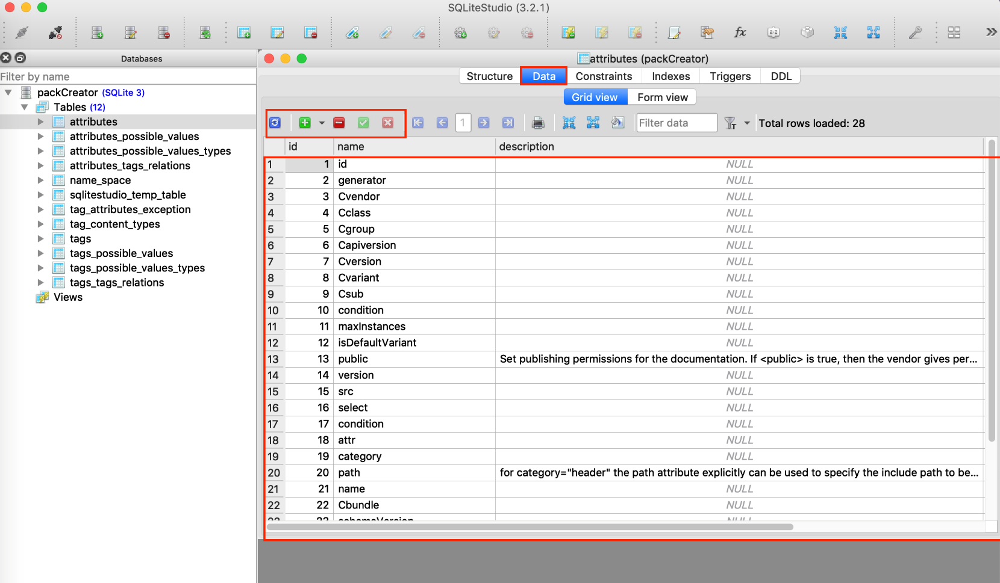

Database Overview
To add or remove element from table : In right panel click on Data tab and modify table
Delete row
Rollback
Insert row
Commit

Slide 24
Thank you!

